Slide 1
Our Future Beeston Energy Saving Handbook
SAVE MONEY – SAVE THE PLANET
19/02/2022

Slide 2
What is Our Future Beeston?
“We are a people-powered movement to create a zero carbon, socially just, and nature friendly Leeds”
Our Future Beeston community centred project to help get Beeston residents involved with tackling climate change and improving the local environment.
It’s part of the wider Climate Action Leeds project, working across the city for real change.
We want to hear your ideas for Beeston, so please contact James to share your thoughts and to find out more.
Email: ourfuturebeeston@gmail.com – Call: 07543 421 520

Slide 3
Contents
4 – Introduction
5 – Saving Water
7 – Water Meters
8 – Help with Water Bills
10 – Saving Gas & Electricity
13 – Smart Meters
14 – Schemes Available
15 – Energy Bill Support
17- Fuel Debt Support
18 – Regularly compare suppliers
19- Priority Services Registers
20 – Tenants Rights
21 – Better Homes Yorkshire Grants
22 – Solar Factsheet
23– Climate Anxiety
24 – Climate Action Leeds

Slide 4
Save Energy, Save Money, Save the Planet
The cost of living crisis means that people across the country are struggling to afford the basic essentials
We are all considering how and where we can save money
Domestic fuel bills have risen up to 54% - 14 times more than the average pay rise
The Government have some help in place but this may not go far enough, and claiming can be confusing and time consuming
This handbook gives advice on how to save energy and money, as well as what help is available to cover costs
All the figures are averages from Energy Saving Trust, based on a 2-3 bed house. Figures are accurate as of Autumn 2022.

Slide 5
Saving Water DID YOU KNOW…
TURNING THE TAP OFF WHILE BRUSHING YOUR TEETH CAN SAVE 6 LITRES OF WATER PER MINUTE
SHORTER SHOWERS: 1 MINUTE OFF EVERY SHOWER CAN SAVE £35 A YEAR. SHORTER SHOWERS WILL ALSO SAVE MONEY ON GAS!

Slide 6
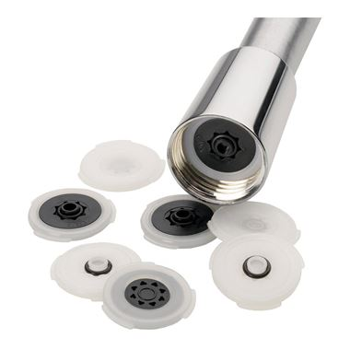
Low-cost ways to save
Fitting a low-flow shower head or flow regulators could save £55/year
Flushing the toilet uses 9 litres of water. Fitting a cistern displacement device can reduce the amount of water, and can be as simple as a brick or an old plastic bottle
WATER COMPANIES SOMETIMES GIVE AWAY FREE CONSERVATION EQUIPMENT
Use a watering can instead of a hosepipe
Use a water butt to water the garden or wash the car
If your shower takes time to heat up, catch the cold water in a bucket and use it to flush the toilet or water your plants

Slide 7
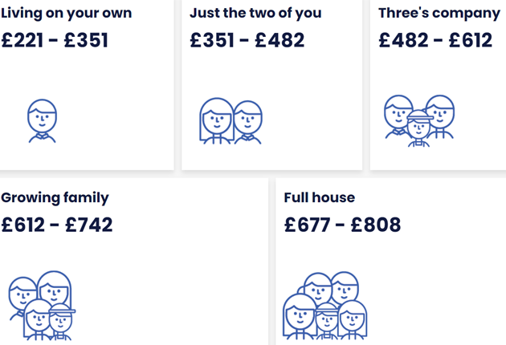
Water Meters
A water meter means you only pay for the water you use
Water rates are based on the number of bedrooms. Generally if you have less people than bedrooms, you’ll save money with a meter
Water companies now allow you to trial a meter for up to 2 years, so if you don’t see the benefit or circumstances change, you can have it removed
Average costs with a meter:

Slide 8
Help Paying Water Bills www.yorkshirewater.com/help-paying-your-bill
WaterSure Scheme
If you have a water meter, claim an income-based benefit, claim Universal Credit and need to use extra water because you have a medical condition or three or more children, you might be able to get help with the WaterSure scheme
This caps your bill at £421.42 this year, but as it’s metered, if you use less, you pay less
Water Support Scheme
If you have a low household income and your annual water bill is more than £421, you might be able to get help with the WaterSupport scheme
It’s different to WaterSure as it’s based purely on income, and you don’t need a meter fitted

Slide 9
Help Paying Water Bills www.yorkshirewater.com/help-paying-your-bill
Water Direct
If you receive a deductible income-based benefit, we can take payments directly from your benefits. Less hassle, less worry!
You can arrange payments through Yorkshire Water by calling:
0345 1299 299
Arrears/debts
If you’re struggling to catch up on previous water bills, the Resolve scheme could help you be debt-free so you can continue paying your water bill in affordable amounts
Community Trust Funds can also wipe debts up to £5000
You can also arrange a payment holiday

Slide 10
LIGHTBULB MOMENT… Saving Electricity
UNPLUG AND SAVE!
23% of the energy we pay for is used by appliances running in the background
Turning off lights = £19/year saving
Installing low energy bulbs = £50/year saving
Defrost fridges and freezers to ensure fans can regulate temperature efficiently
Keep fridges/freezers full, as solid items stay cold longer than empty space. A bag of ice is perfect for this and the appliance kicks in less as a result
Unplugging appliances when not in use could save up to 23% of your yearly bill
Washing at 30 instead of 40 uses 40% less energy.
Ensure you have a full load before putting a wash on, this saves electricity and water!
Hang clothes outside or on an airer when possible - tumble dryers cost around £200/year to run

Slide 11
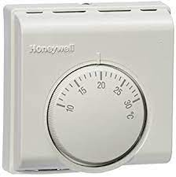
KEEP WARM, SAVE MONEY
SET THE THERMOSTAT BETWEEN 18-21 DEGREES
SAVE £105 FOR EVERY 1 DEGREE YOU TURN IT DOWN ACROSS THE YEAR
SET TIMERS TO MAKE THE MOST OF YOUR HEATING
TURN RADIATOR TRV’s DOWN IN ROOMS YOU USE LESS
CLOSE CURTAINS & BLINDS TO KEEP HEAT IN AT NIGHT

Slide 12
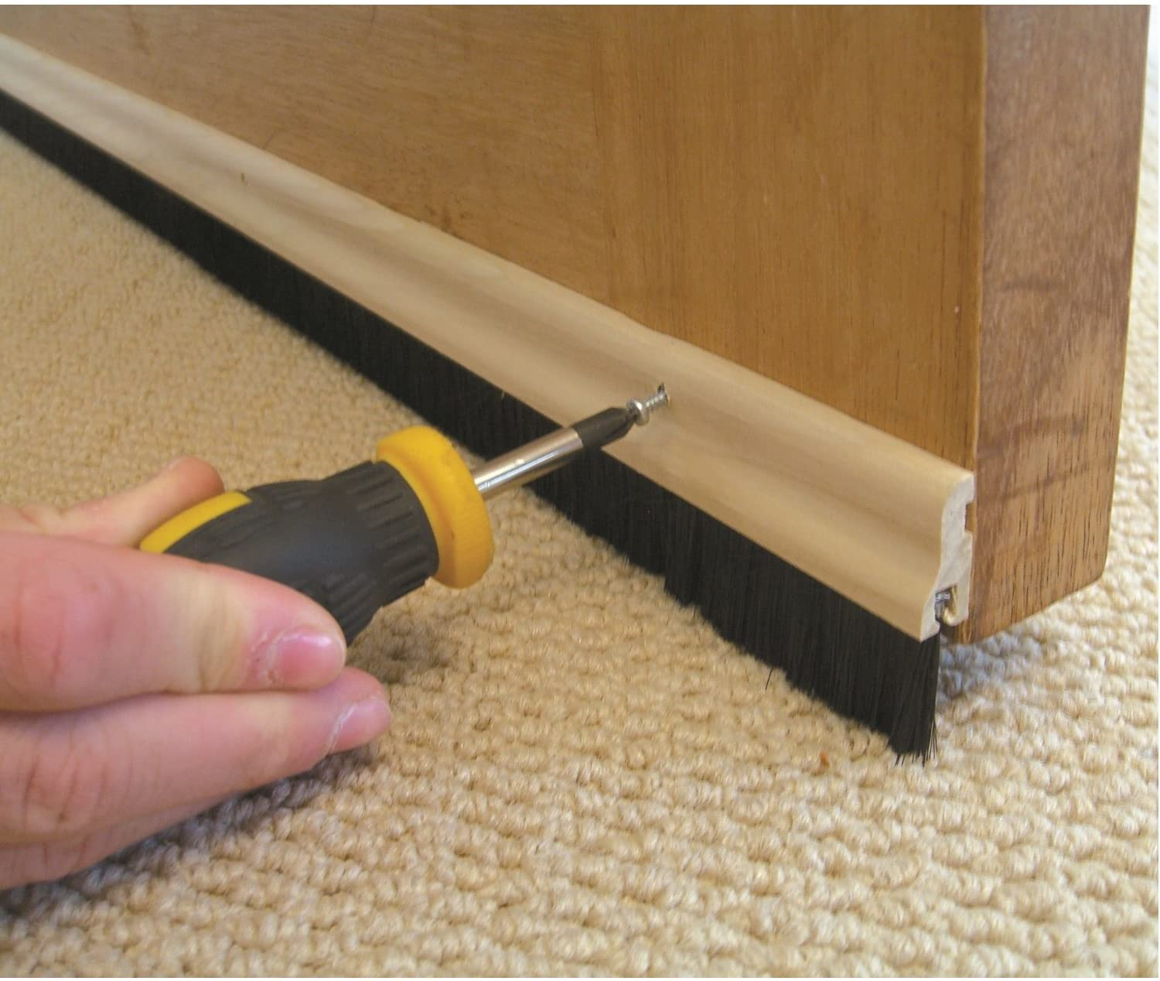
LOW COST DIY STEPS TO A WARMER HOME
REFLECTIVE PANELS BEHIND RADIATORS - Cost: £7 for a 4m roll – Saving: £25/Yr. These can reflect 50% of the heat which would be lost into the wall, back into the room
SEAL OFF UNUSED CHIMNEYS – Cost: £10-£20 – Saving: £65/Yr (40m3 warm air per hour escapes up open chimneys. This creates draughts meaning warm air needs replacing)
DRAUGHT PROOFING DOORS & WINDOWS: Cost from £1 - Saving: £45/Yr
USE AIRER TO DRY LAUNDRY: Cost from £10 – Radiators aren’t blocked, Reduces Condensation, Avoids tumble dryer saving up to £200 per year

Slide 13
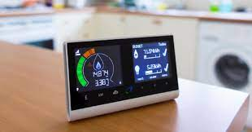
Smart Meters What are the facts?
There is some confusion around smart meters:
You won’t save money just by having one
Automatic meter readings mean you pay for what you use, with no more estimates and less hassle
You can see in £££ how much you are using, and how much you save when you turn things off!
You can set target budgets
Great to teach children about energy saving and encourage conservation behaviours
Easily view the credit/debit status of your account
Contact your supplier to discuss further or arrange to have a smart meter fitted

Slide 14
HELP PAYING YOUR ENERGY BILLS AND MAXIMISING EFFICIENCY WHAT HELP IS AVAILABLE?
WARM HOMES DISCOUNT
WINTER FUEL PAYMENT
BOILER REPAIR GRANT SCHEME
BETTER HOMES YORKSHIRE
MONEY ADVICE SERVICE
ENERGY COMPANY OBLIGATIONS (ECO/ECOFLEX)
ENERGY SUPPLIER TRUST FUNDS
GREEN HOMES GRANT
WATER BILL CAP FOR HEALTH ISSUES OR LOW-INCOME

Slide 15
ENERGY BILL PAYMENT SUPPORT
What support is available to help pay rising costs?
Discounts & Savings
Warm Homes Discount
-£150 credited to your account
-If you get Pension Credit
-If you have low income
-Apply through your provider
Cold Weather Payment You’ll get £25 for each 7 day period of very cold weather (zero degrees) between 1 November and 31 March. Eligible through certain benefits or mortgage interest support
Winter Fuel Payment
An automatic payment of between £100-£300 paid once you reach a certain age
Yorkshire Water
WaterSure: Capped bill if you’re on certain benefits, have medical conditions resulting in higher usage, or 3+ children.
Community Trust grants for debts

Slide 16
HELP PAYING YOUR ENERGY BILLS
WARM HOMES DISCOUNT | WINTER FUEL PAYMENT
£150 credited to your account Apply directly through supplier Anyone on pension credits Low-income households The money won’t be paid to you directly. If you are a credit customer it’ll be added to your electricity account. And if you’re on Pay As You Go, you’ll be sent a voucher that you can use to top-up your meter | £100-£300 Born before set date each year to qualify Should receive automatically from the government Most payments are made in November and December. Contact the Winter Fuel Payment Centre if you do not receive your payment as expected

Slide 17
FINANCIAL SUPPORT FOR FUEL DEBTS
Money Helper/National Debt Line | Energy Supplier Trust Funds | Step Change Debt Charity
Provide general advice and support Free and impartial Create a financial plan to help manage income Income/outgoing calculator tool Government endorsed | If you’re in debt, you may get a charitable grant to pay it off British Gas offer these whether you’re a customer or not Other providers offer them only to customers You need to have received debt advice ‘Charis Grants’ or Citizens Advice can help with applications | Experts in debt management Help with all types of debt and have multiple solutions to suit you Set up Debt Management Plan Assist with writing off debt (DRO) Provide mental health support
Always contact your supplier first, as they can arrange payment plans

Slide 18
Regularly Compare Suppliers
It’s important to check you’re on the best tariff for your energy
Even if your bill says ‘you’re on our best deal’, there may be another company who can offer it cheaper
Weigh up the pros & cons of switching; are there early exit fees, what’s the payment method, customer service options with new provider – is it all online, is the price variable, what’s the length of the contract?
Simply Switch and Citizens Advice Comparison Tool give free and impartial results, meaning there aren’t any sponsored adverts.
Simply Switch also have a phone number if you prefer to call: 0800 011 1395

Slide 19
Priority Services Registers
Utility providers offer Priority Services Registers for vulnerable customers
You will be notified of any disruption to the services e.g. a power cut, given regular updates and any support you need until it’s back to normal
These are especially targeted at older people, anyone with health conditions or disabilities, people with medical equipment requiring electricity or water, and people with medication which needs to be kept in the fridge
Northern Powergrid operate the energy network and have their own PSR
Yorkshire Water have a PSR
Your supplier may also have a similar register to join for priority notifications

Slide 20
Your Rights as a Tenant Council, Housing Association and Private Tenants often face difficulty getting essential work carried out
Shelter and Citizens Advice can give free expert advice when you have a dispute
The landlord must have a Gas Safe engineer service your boiler annually
If your boiler is faulty, you have poor insulation or something breaks down, the landlord must repair or improve it.
Housing Association tenants should have a support worker assigned to assess any issues and help with the process of getting issues resolved
Grants for private owners are often the same grants available to private landlords, but landlords may have to contribute financially towards any work
Housing Associations and Councils should run their own schemes and do any work which is required

Slide 21
Better Homes Yorkshire
Homeowners, private tenants and landlords will be able to install energy-saving technology completely free of charge (alternative schemes for social housing tenants)
Free Solar PV
Up to 4kwh system – enough power for household of 5
For anyone with EPC of E,F,G
Discounted New A-Rated Boiler
Save £305 a year on bills
New boiler for under £2000
Free Insulation
Cavity wall, Loft, Attic Room
EPC ratings D,E,F,G
Apply online OR
Apply online or call 0800 597 1500
Apply online OR
email wayne.kenwards@eclipseenergy.co.uk
email hedley.purton@acooleelectrical.co.uk
Availability varies by local council
Email: ourfuturebeeston@gmail.com – Call:07543 421 520

Slide 22
Solar: Facts and Benefits
Is solar right for you?
4KWh system powers household of 5 people
If there is visible light, your system will generate energy – cloudy or not
Incredibly safe, no danger of chemical leaks or toxic fumes
Silent to run so minimal impact on immediate environment
Apply for FREE solar with Better Homes Yorkshire
GET PAID for excess energy you produce
Installation takes around 3 days, then you can track how much energy it generates
South facing, unshaded rooftops are ideal, but almost any house can have solar fitted. You can arrange a survey of your house through Better Homes Yorkshire, to check if your property is suitable

Slide 23
ENVIRONMENTAL HEALTH: how to beat climate anxiety
45% of young people say worrying about climate change affects their daily life
Climate anxiety is a reasonable response to a real, existential threat
Birth-rates are down because people are thinking twice about the impact that having children has on the planet, and the state of world they will grow up in
Do your bit, start feeling better:
Adopt energy saving behaviour
Get a reusable cup or bottle to reduce waste
Use public transport, lift-share or cycle to school or work
Volunteer with a climate charity and campaign for change
It doesn’t need to be perfect, millions doing a little is better than a handful doing a lot

